Slide 1
Global Warming
A Major Issue In Our Present World
By Swetha

Slide 2
What is global warming? Global warming is when the earth heats up (the temperature rises). It happens when greenhouse gases trap heat and light from the sun in the earth’s atmosphere, which increases the temperature. This hurts many people, animals, and plants. Many cannot take the change, so they die.

Slide 3
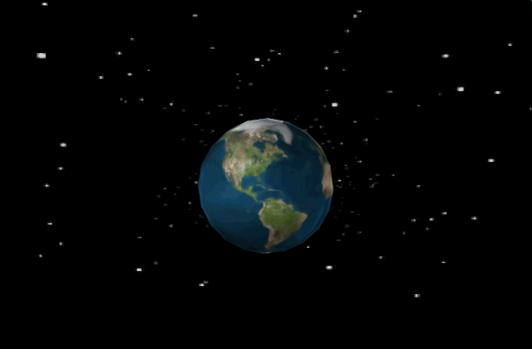

Slide 4
Causes
Release of methane gas from tundra and wetlands. Methane is a greenhouse gas. A greenhouse gas is a gas that traps heat in the earth's atmosphere.
Pollution is one of the biggest problems. Burning fossil fuels is one thing that causes pollution. When fossil fuels are burned they give off a green house gas called CO2.
Another major cause of Global Warming is population. More people means more food, that means more methane because there will be more burning of fossil fuels

Slide 5
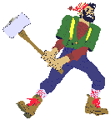
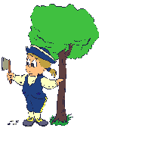

Slide 6
Role of deforestation
Deforestation is the removal of a forest or stand of trees where the land is there after converted to a nonforest use.
Examples of deforestation include conversion of forestland to farms or urban use.
Deforestation is bad because we need trees to provide us oxygen and if all the trees are cut down we have less oxygen and it causes global warming.
In fact, 20% of global warming is caused by deforestation.

Slide 7
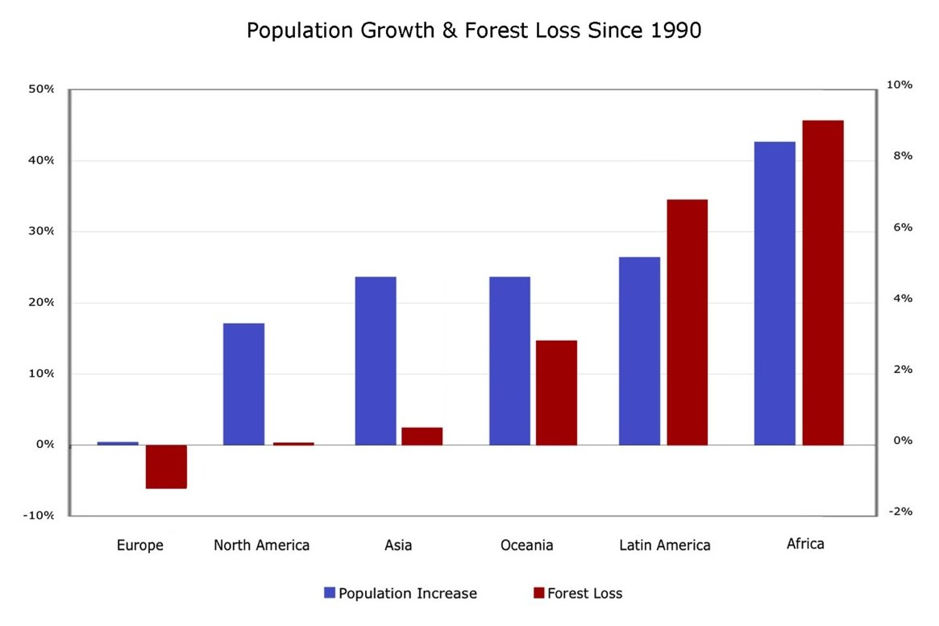

Slide 8
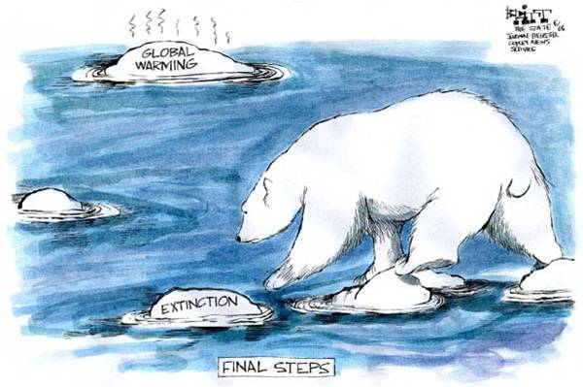
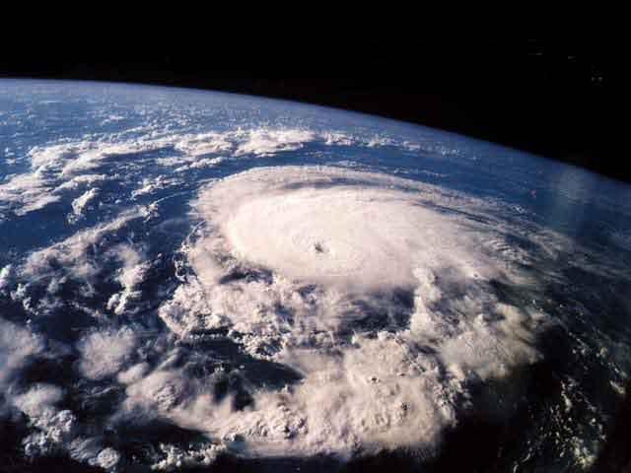
Effects of Global Warming
Ice is melting worldwide, especially at the earth’s pole.
Rain and snowfall has increased across the globe, on average.
Some butterflies, foxes, and alpine plants have moved farther north or to higher, cooler areas.
Hurricanes and other storms are likely to become stronger

Slide 9
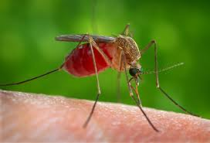
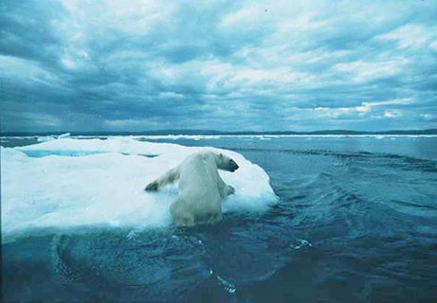
Plants could bloom earlier than their pollinating insects to become active.
Some diseases will spread, such as malaria carried by mosquitoes.
2005 was officially the hottest year in recorded history.Five decades ago w were warned about climate change from burning fossil fuels
Other effects could happen later this
century, if
warming continues…

Slide 11
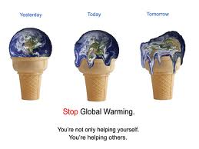
YESTERDAY
TODAY
TOMORROW
STOP
GLOBAL WARMING
Click Here to watch a video on Global Warming

Slide 12
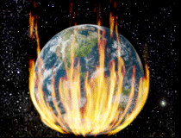

Slide 13
Solutions to prevent global warming.
Use flourescent bulbs instead of normal ones.
For going nearby, use bicycle instead of a car.
Unplug appliances when not in use.
Use a clothes line instead of a dryer.
Reuse paper so that less trees are cut.
Try using energy saving appliances.

Slide 14
Thank You
By Swetha Sanjay Sindhu
Class 7-I

